Slide 1
Academic Insights Dashboard
Tableau - Reinforcement Kavitha Balasubramaniam DA_DS – Batch 08

Slide 2
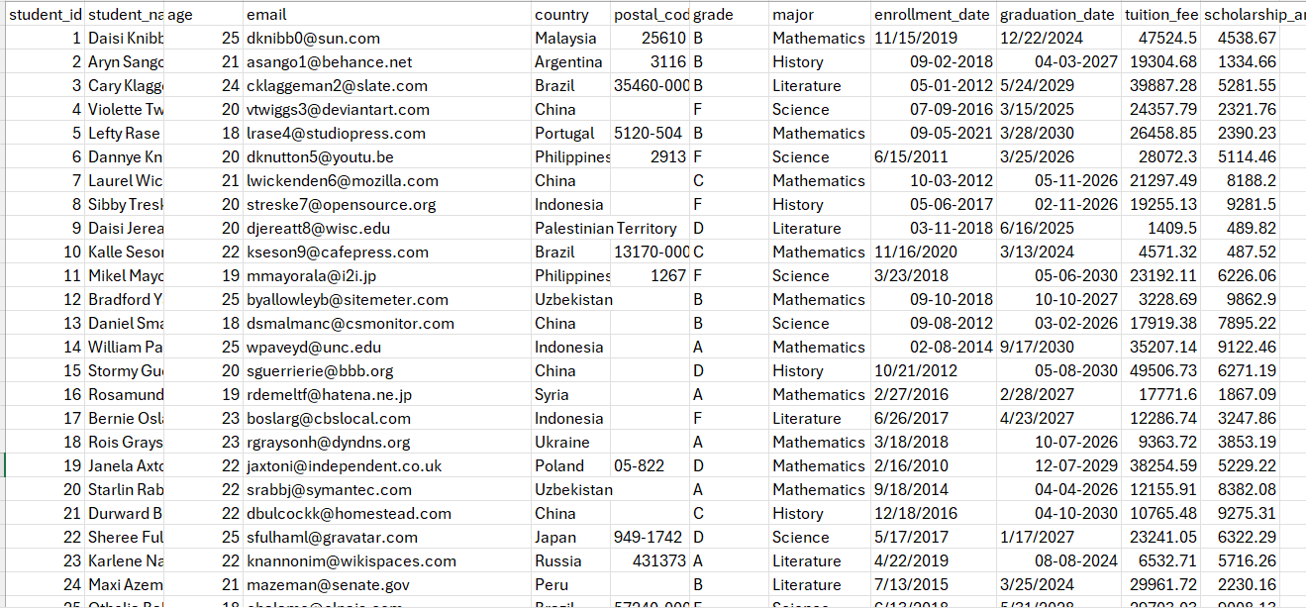
Dataset Overview
Dataset contains 1000 records.
Key attributes include: Student ID, Name, E-Mail, Country, Enrollment date, Grade, Graduation Date etc.

Slide 3
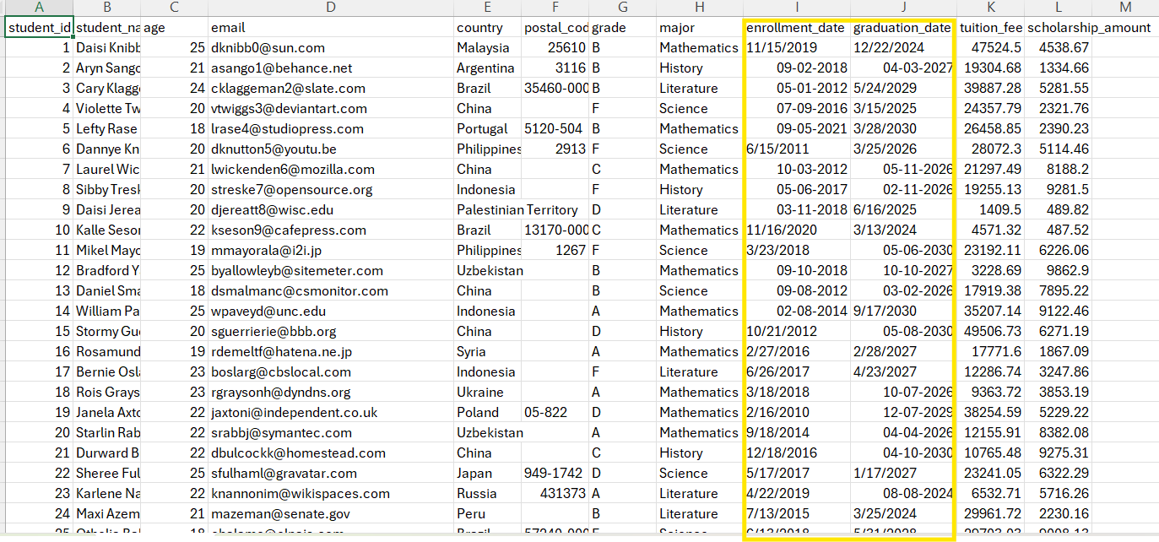
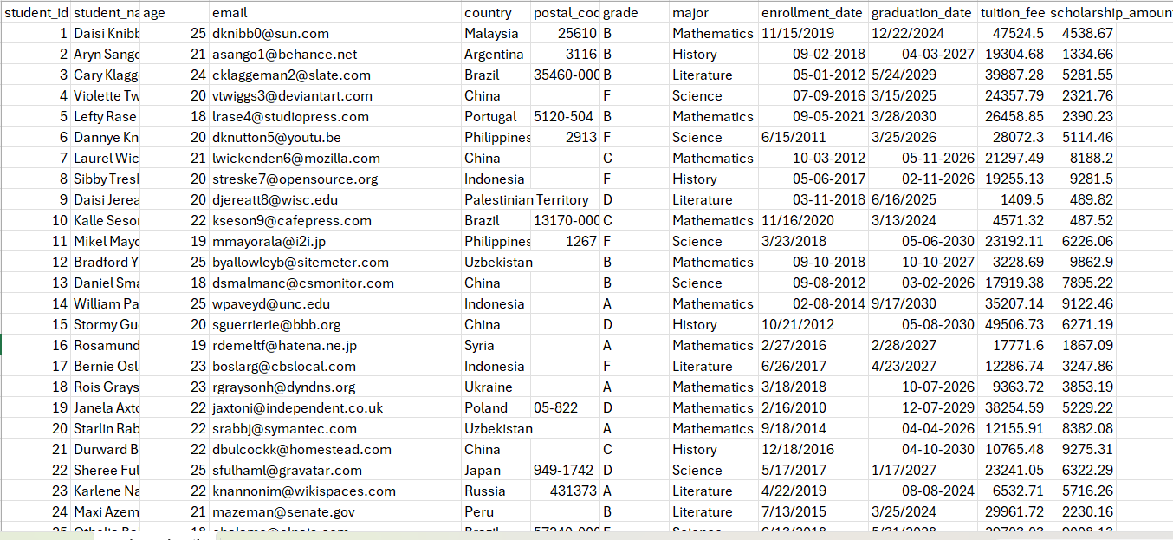
Data Cleaning Process
Raw Data
Cleansed Data

Slide 4
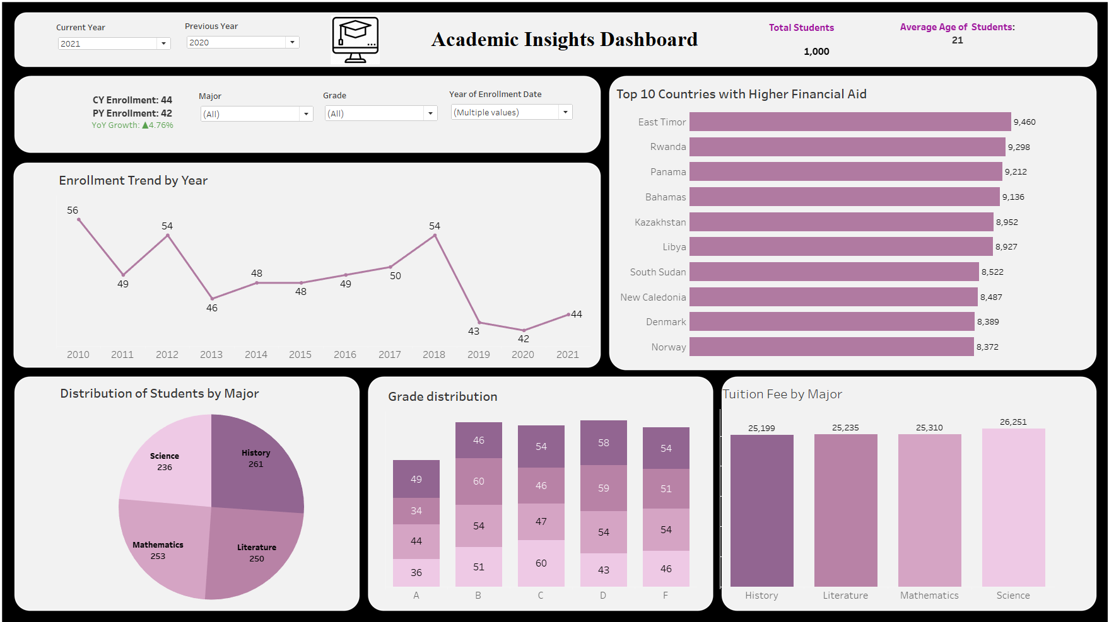
Dashboard Overview

Slide 5
Key Insights & Recommendations
Enrollment peaked in 2010 (56 students) and again in 2018 (54 students).
YoY Growth shows a +4.76% increase, indicating early signs of recovery in 2021.
East Timor, Rwanda, and Panama top the list for scholarship amounts.
Scholarships are not concentrated in specific continents, suggesting a diverse international student aid policy.
Grade B is most common, followed by C and D.
F grades are relatively high, indicating a potential academic performance issue.

Slide 6
Conclusion
The dashboard shows balanced enrollment across majors with stable tuition fees.
A slight YoY enrollment growth (+4.76%) in 2021 suggests recovery after a dip between 2018–2020.
Grades D & F are relatively high, indicating a need for academic support programs.
Financial aid is concentrated in a few countries — a review of distribution strategy is recommended.
Continued monitoring and targeted improvements can drive student success and institutional growth.

Slide 7

Kavitha Balasubramaniam
26-05-2025

